Slide 1
QUIZZES FROM LAST TOPICS TOTAL MARKS = 05 TIME ALLOWED = 45 Minutes

Slide 2
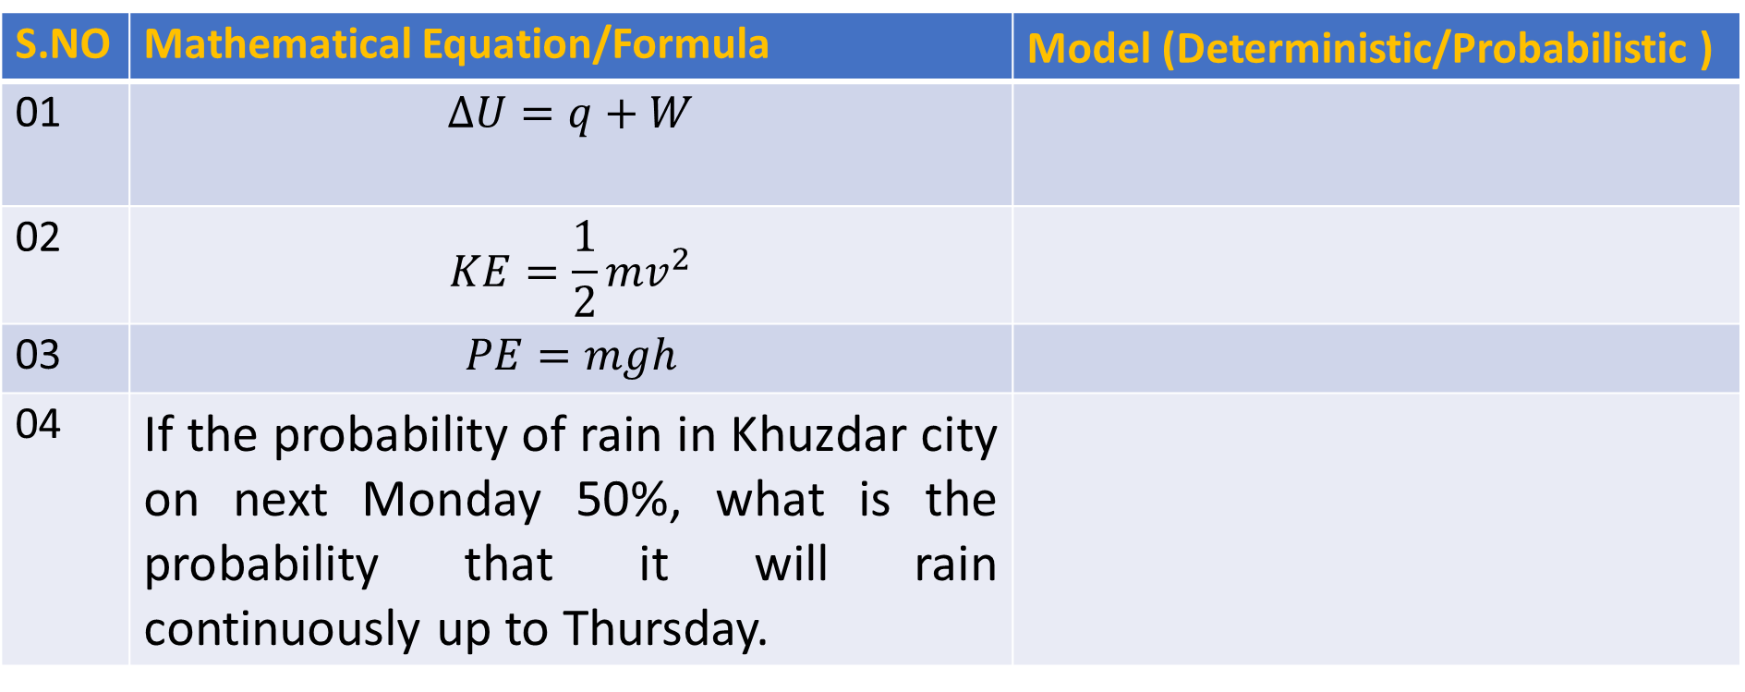
Q: NO: 01: Identify from the below mathematical, whether we design a Deterministic Model or Probabilistic Model Time Allowed: 10 minutes
QUIZ-01 (From Topic-1)
S.NO | Mathematical Equation/Formula | Model (Deterministic/Probabilistic )
01 | $$∆U=q+W$$
02 | $$KE=\frac{1}{2}mv^{2}$$
03 | $$PE=mgh$$
04 | If the probability of rain in Khuzdar city on next Monday 50%, what is the probability that it will rain continuously up to Thursday.

Slide 3
Q: NO: 02: Flip a coin 5 times. List the Tree Diagram and Sample space. Time Allowed: 15 minutes
QUIZ-02 (From Topic-2)

Slide 4
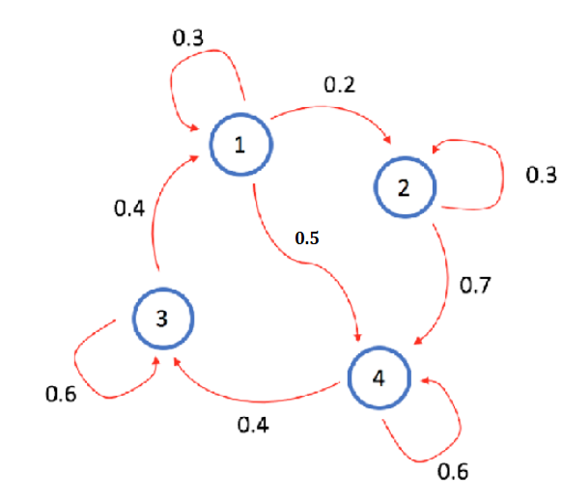
QUIZ-03 (From Topic-3)
Q: NO: 03: Calculate the Transition Matrix from the given below Transition Diagram Time Allowed: 15 minutes

Slide 5
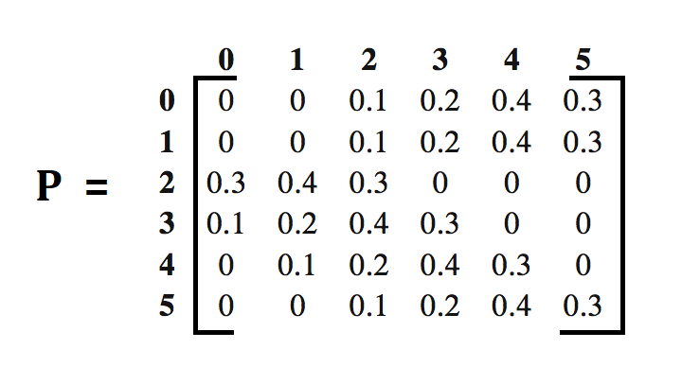
QUIZ-04 (From Topic-4)
Q: NO: 04: Draw the Transition Diagram from the given below Transition Matrix
Time Allowed: 15 minutes

Slide 6
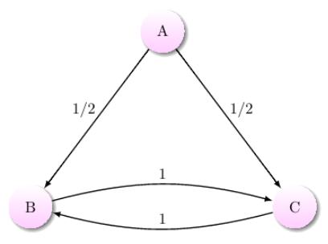
QUIZ-05 (From Topic-5)
Q: NO: 05: Tick the correct Option (True/False).
1) State A is Recurrent State (T/F)
2) State B is Transient State (T/F)
State C is Recurrent State (T/F)
Time Allowed: 10 minutes

Slide 7
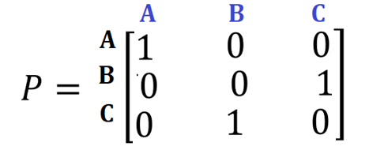

QUIZ-06 (From Topic-6)
Q: NO: 06(a) Check whether Markov Chain Transient Matrix is Irreducible or Not Irreducible?
Time Allowed: 05 minutes
$$P=\left[\begin{matrix}1 & 0 & 0 \\ 0 & 1 & 0 \\ 0 & 0 & 1\end{matrix}\right]$$
Q: NO: 06 (b) Check whether
State A is an Absorbing State (T/F)
State B is an Absorbing State (T/F)
State C is an Absorbing State (T/F)
Time Allowed: 05 minutes

